Slide 1

Bird Strikes Analysis (2000-2011)
Analyzing the Impact of Bird Strikes on US Aviation
Mandla Jagadish

Slide 2
Introduction
Content :
Brief overview of bird strikes and their impact on aviation safety. Importance of data analysis in addressing bird strikes.

Slide 3
Problem Statement
Transport and communication are in the crucial domain in the field of analytics. Environmental impacts and safety are, nowadays, two major concerns of the scientific community with respect to transport scenarios and to the ever-growing urban areas. These issues gain more importance due to the increasing amount of vehicles and people. Seeking new solutions is reaching a point where available technologies and artificial intelligence, especially MAS, are being recognized as ways to cope with and tackle these kinds of problems in a distributed and more appropriate way. A bird strike is strictly defined as a collision between a bird and an aircraft which is in flight or on a take-off or landing roll. The term is often expanded to cover other wildlife strikes - with bats or ground animals. Bird Strike is common and can be a significant threat to aircraft safety. For smaller aircraft, significant damage may be caused to the aircraft structure and all aircraft, especially jet-engine ones, are vulnerable to the loss of thrust which can follow the ingestion of birds into engine air intakes. This has resulted in several fatal accidents. Bird strikes may occur during any phase of flight, but are most likely during the take-off, initial climb, approach and landing phases due to the greater numbers of birds in flight at lower levels. To have a closer look the following document visually depicts the data collected on Bird Strikes by FAA between 2000-2011

Slide 4
Data Cleaning and Transformation
cleaned the data, including handling missing values, removing duplicates, and correcting data types.
transformations applied, such as creating new columns, deleting unwanted columns, filtering data, and aggregating information.

Slide 5
Case Studies
● Visuals Depicting the Number of Bird Strikes
● Yearly Analysis & Bird Strikes in the US
● Top 10 US Airlines in terms of having encountered bird strikes
● Airports with most incidents of bird strikes – Top 50
● Yearly Cost Incurred due to Bird Strikes:
● When do most bird strikes occur?
● Altitude of aeroplanes at the time of strike
● Phase of flight at the time of the strike.
● Average Altitude of the aeroplanes in different phases at the time of strike
● Effect of Bird Strikes & Impact on Flight
● Effect of Strike at Different Altitude
● Were Pilots Informed? & Prior Warning and Effect of Strike Relation

Slide 6
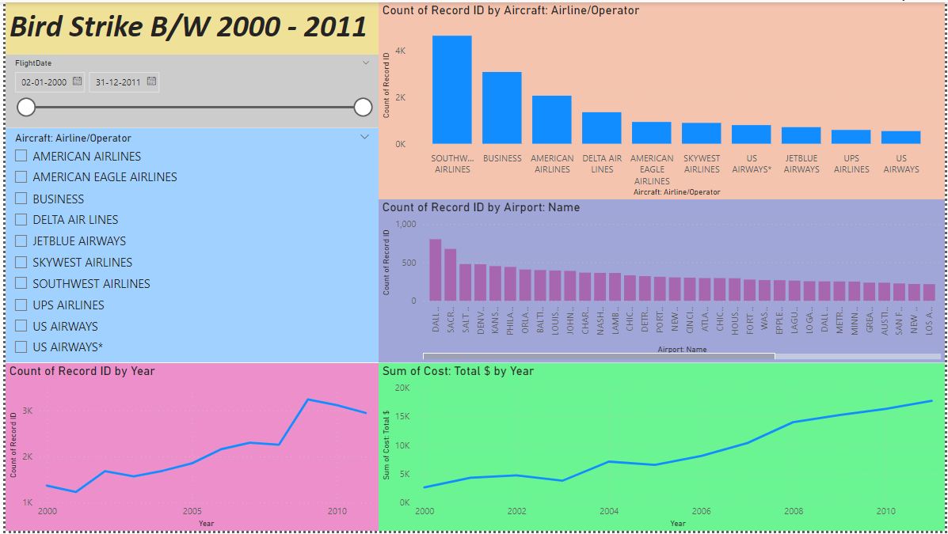

Slide 7
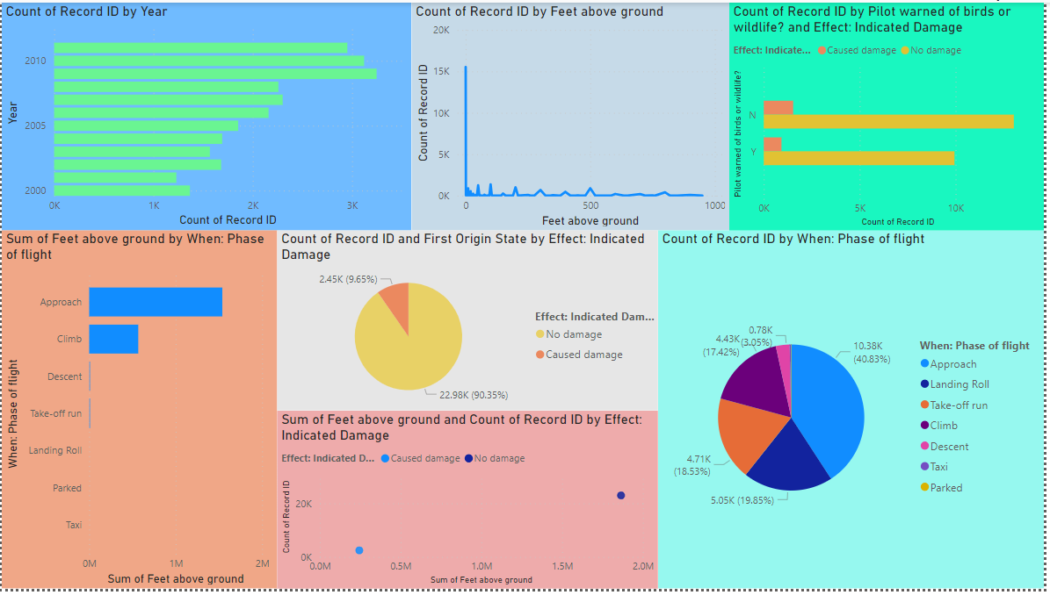

Slide 8
Thank You

